Slide 1
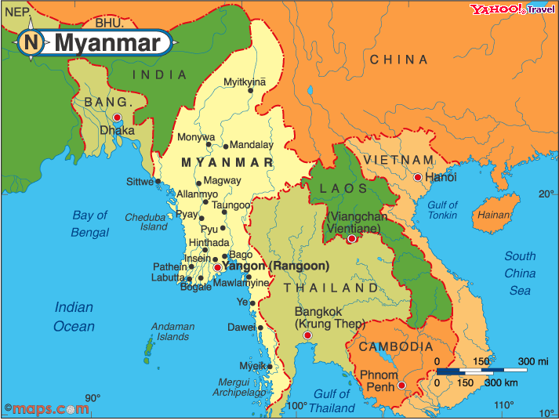

Slide 2
Burma Refugees at a Glance
Since 2006-2017, there are over 120,000-140,000 Burma refugees resettlement into the U.S. through the United Nations Higher Commissioner for Refugees (UNHCR) that work alongside with nine umbrella resettlement social service agencies.
Church World Services, one of the nine umbrella agencies, partner with American Baptist Home Mission Societies’ (former) Office of Immigration and Refugee Services to help sponsor the Burma refugees.

Slide 3
ABC Burma Refugee Task Force
The Task Force was initiated in 2007 by the General Executive Council recommended by Dr. Roy Medley, General Secretary Emeritus. It was a joint effort from the Office of the General Secretary, the American Baptist Home Mission Societies, International Ministries, American Baptist Women’s Ministries, Karen Baptist Churches USA, Chin Baptist Churches USA, and local church pastoral leaders.

Slide 4
The goals of the Task Force are:
To inform the larger ABC family about the refugees situation and the resettlement process
To encourage churches reaching out for sponsorship & engage in refugee ministries
To seek resources for refugee ministries in local churches and regions
To build support networks for the “Diaspora Communities” and among local congregations
To advocate for religious freedom, peace and justice.

Slide 5
Burma Refugee Commission
The Burma Refugee Task Force was renamed into Burma Refugee Commission by the Board of General Ministries in June 2014.
The Commission continues its goals and work closely with various ethnic conventions and associations.
The Karen Baptist Churches USA and Chin(Haka) Baptist Churches USA were recognized by the Board of General Ministries (BGM) as an Associate Ministry Organization (AMO) in June 2014.

Slide 6
Burma Refugee Commission
The Kachin Baptist Churches USA was recognized as an AMO in June 2016.
The Kachin American Baptist Association (KABA) was recognized as an AMO in
The Commission also works with the Burmese Christian Association of North America, Myanmar Baptist Churches USA, Chin(Falam) Baptist Association of North America although they are not part of the AMO.

Slide 7
Burma Diaspora Churches:
The ethnicity of the Burma diaspora churches include the Chin who are Haka, Falam, Lisu; Kachin, Karen, Karenni, Mon, Shan, and few other minority groups.
70%-80% of 140,000 refugees have historical tie with American Baptists traced back to Adoniram Judson’s mission began in Burma in 1812.

Slide 8
Burma Diaspora Churches:
As of December 2017/2018, there are 329 communities being identified in over 130 cities & states; they are residing in thirty different ABC regions.
About 150 churches and fellowship groups have affiliation with ABC/USA via ABC regions and AMO status.

Slide 9
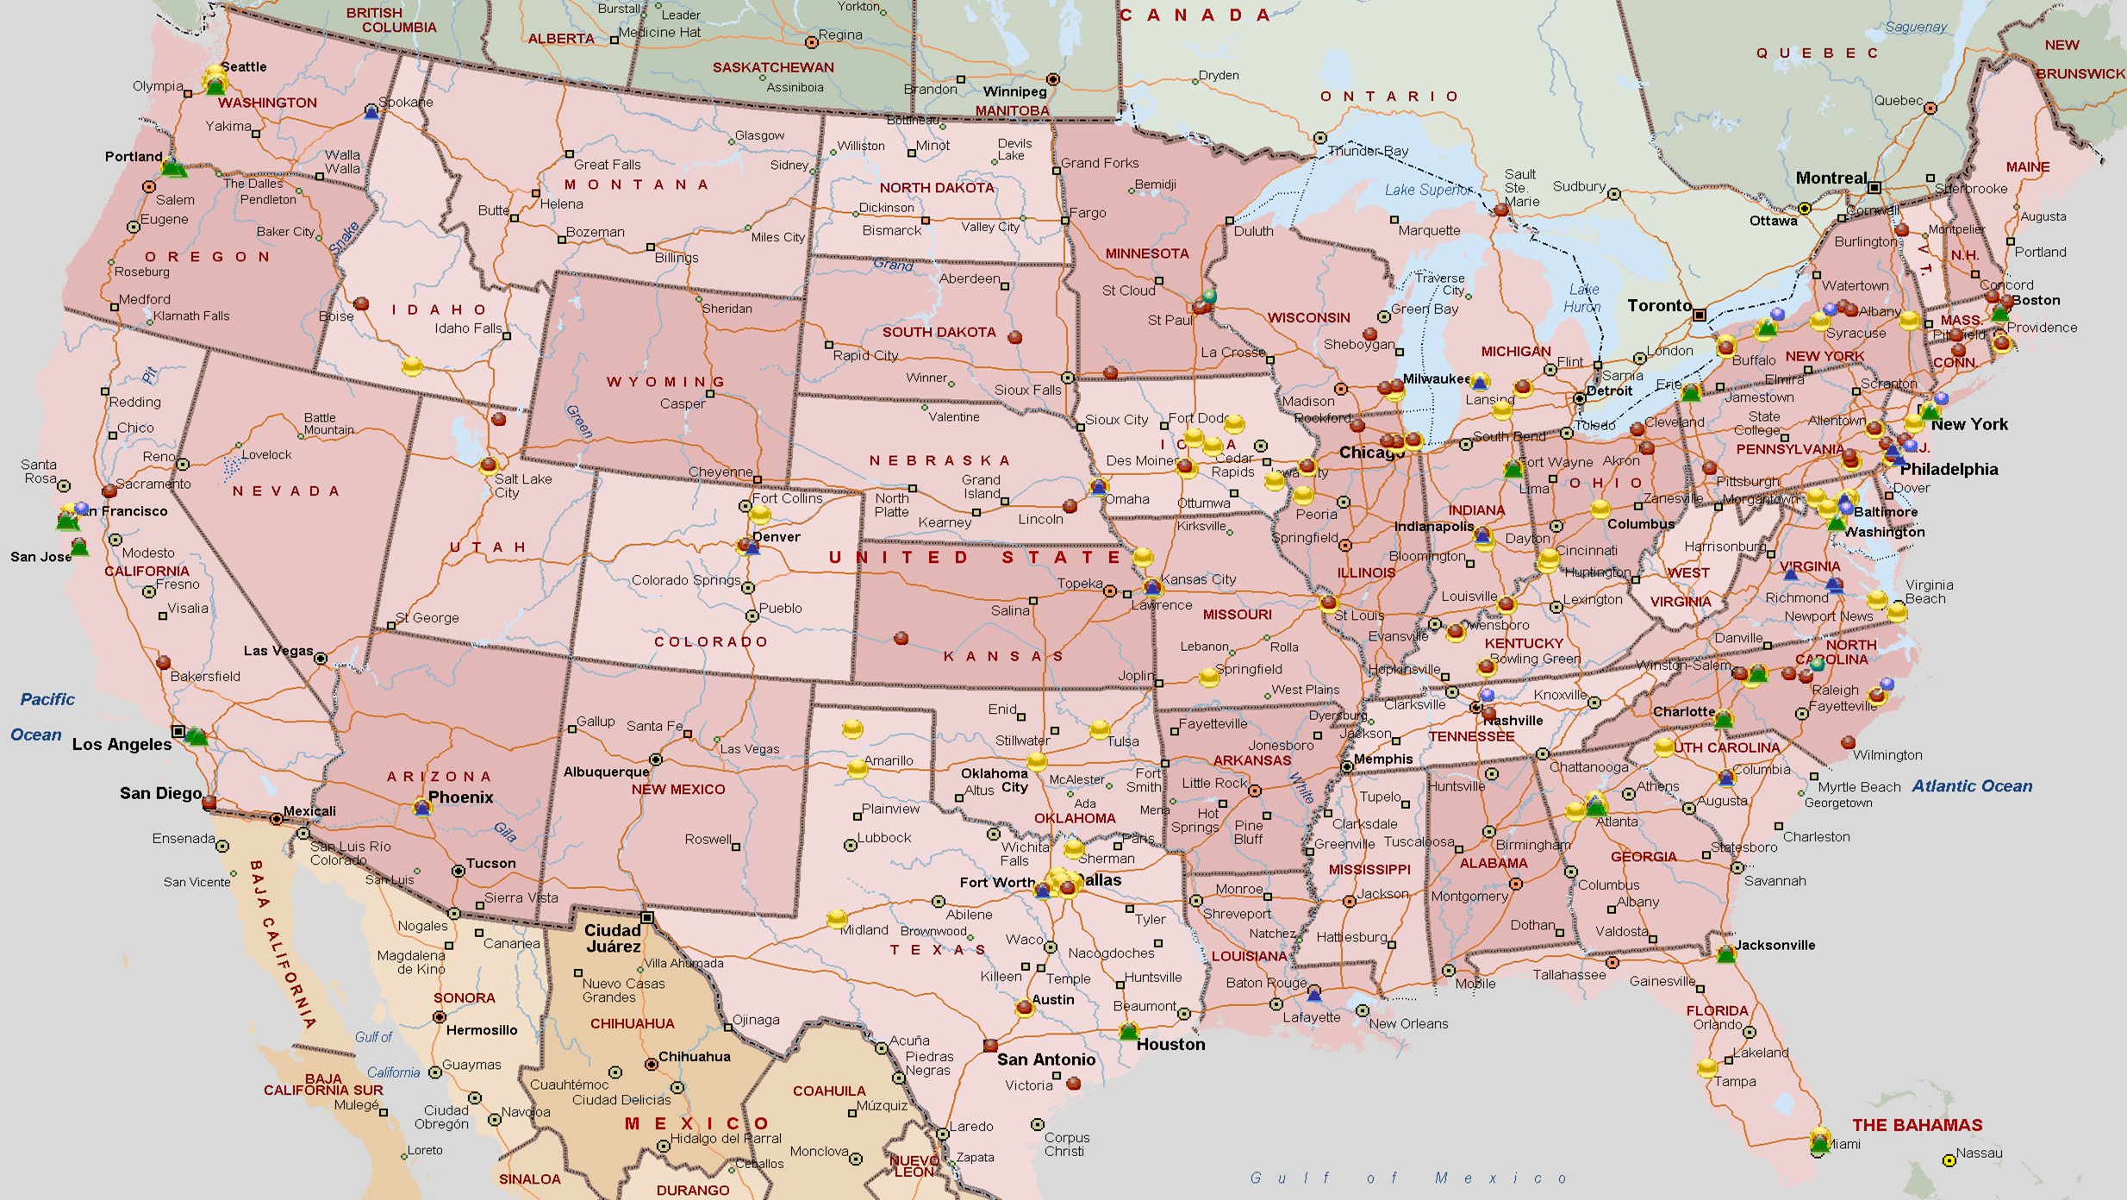
Burma Diaspora Community and Church Locations in the United States: 2006-2018

Slide 10
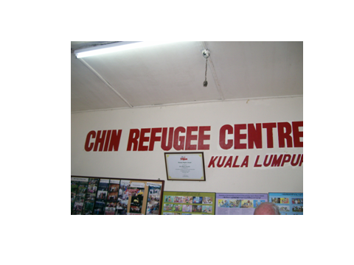
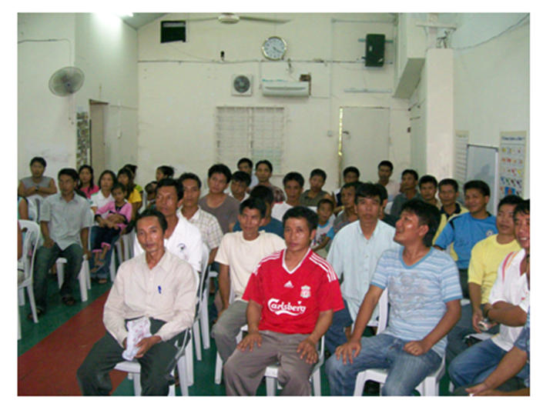
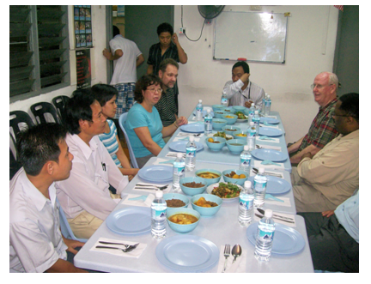

Slide 11
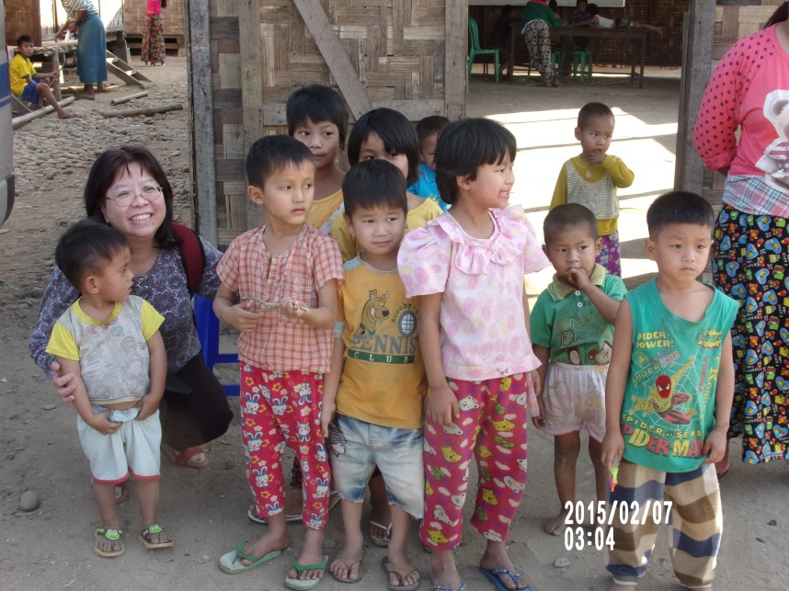
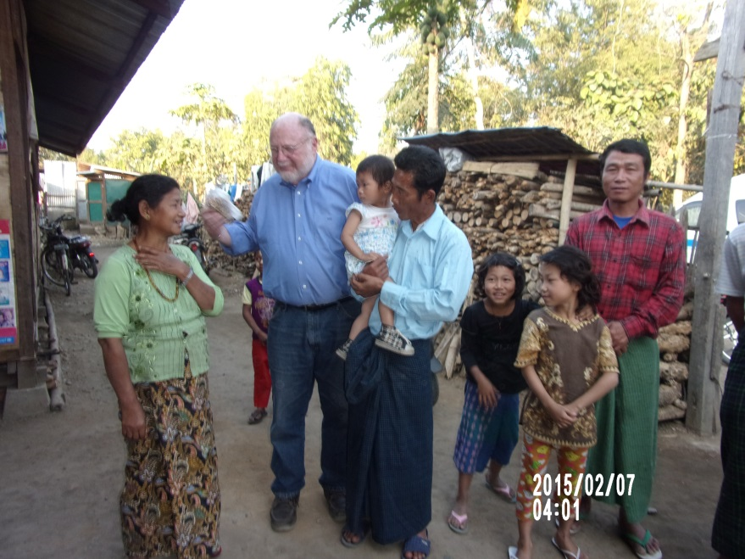
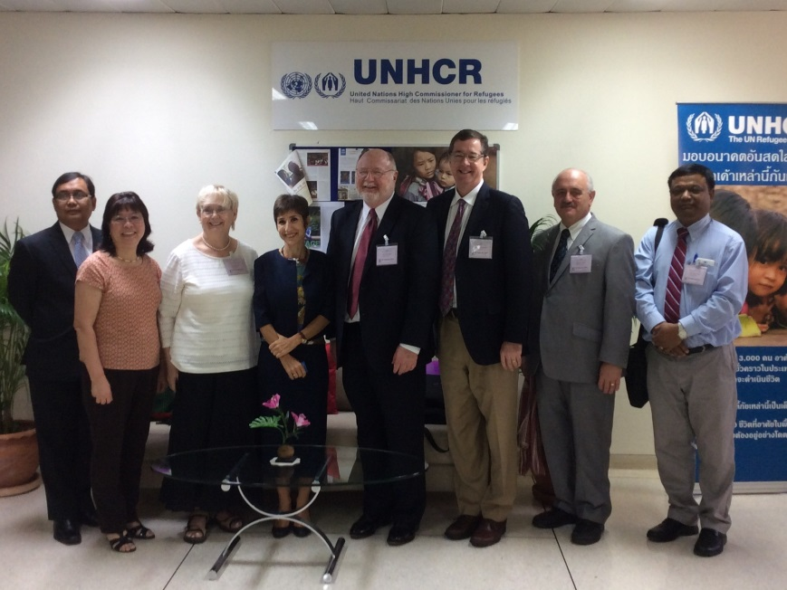
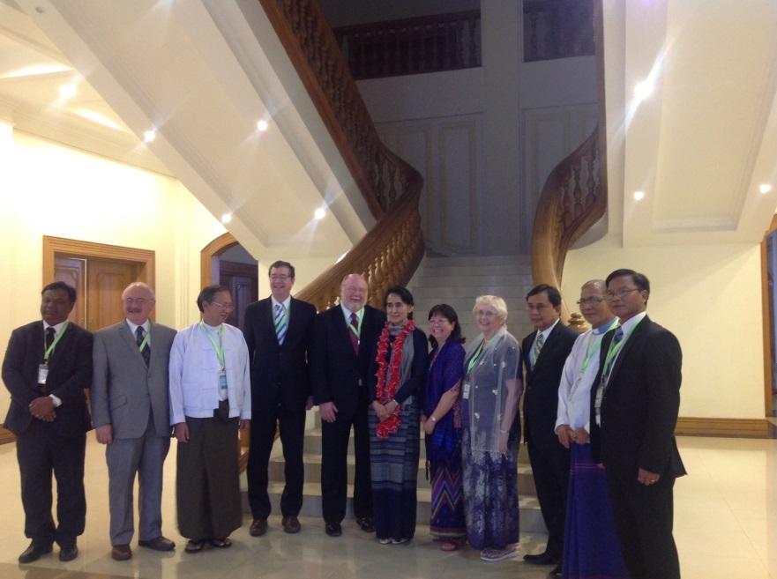

Slide 12
